Slide 1

Products & Services
Home
Blog
News
FAQs
……..the kobo lender
We offer Micro loans & advisory to individuals and small businesses to support their financial needs.
.
Everyone deserves a helping hand whenever the need arises without losing face

Slide 2
OUR PRODUCTS & SERVICES
We shall be offering a varieties of Products and Services within the parameter of Micro lending to individuals and small businesses.
The products and services will include:
Loan to Individual and small business ( Both digital and non-digital
Personal Loan
Salary Loan
Assets Financing /Leases
Working Capital
School fees loan
Stock Finance
Invoice Discounting
LPO
Providing Financial advisory services

Slide 3

Personal Loan
This is an amount of money you can borrow to use for a variety of purposes. It allows you to borrow cash for personal expenses and then repay those funds over time.
Person Loans are a type of instalment debt that allows you to obtain a lump and spread the payment over a specified period of time.
Personal loan can used for a number of personal expenses such as :
Moving expenses
Debt consolidation
Medical bills
Wedding expenses
Home renovations or repairs
Funeral costs
Vacation costs
Unexpected expenses

Slide 4
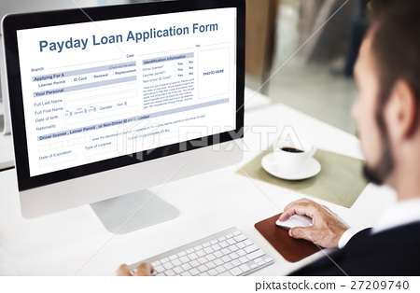
Salary Loan/Pay day
Salary loan or Payday loan is the loan given to employed of recognized institution that must be paid in full or on instalments when the borrowers receive their next pay -check.
The loan amounts granted are typically fairly small and are based on the gross amount of money the borrower earns for each pay period.
It is can be used to settle an unexpected expenses pending the payment of the monthly salary.

Slide 5
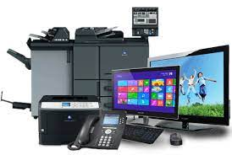
Assets Financing /Leases
This products exist to help our customers buy assets with a loan support based on a certain percentage of the cost of the assets.
The assets in question is used as the collateral and the product is available to both Individuals and small business .
It should be noted that in most cases the assets financed must be insured by the customer.

Slide 6

Working Capital Loan
These are loans for small and medium enterprises business that fund their everyday business operations. It is a flexible loan option for small businesses that need cash quickly to cover immediate expenses.
The loans are often used by cyclical businesses during the off-season to finance their cash cycle — the debt of which is paid down during the busy season.

Slide 7

School fees loan
This is a short -term loan that is intended to facilitate the prompt payment of school fees by parents and guardians for their children and/or ward's educational needs such as tuition fees, uniforms, books, meals ,boarding among others

Slide 8

Stock Finance
This is a type of loan where a customer takes the loan solely to purchase products to sell or used as a raw materials for production.
Stock financing enables a company to effectively manage its working capital and to improve cash flow.

Slide 9

Invoice Discounting
This is when a business obtains a loan based on its confirmed unpaid invoices which are used for collateral for the loan.
This loan product is designed to allow businesses get some some of their outstanding invoices paid earlier and is based on a certain percentage of the confirmed invoice .
The loan is repaid once the invoice is fully settled

Slide 10

Local Purchase order
This is a short- term financial option designed to assist small businesses supply a confirmed order to a company in the list of our approved company.
The loan is also based on a certain percentage of the order .

Slide 11

Financial Advisory Service
We also provide the following services
Management Consulting
Training & Research
Risk Management
Corporate Governance
Investment Advisory
Accounting
Etc

Slide 12


